Slide 1


The Intersection of Time & Stress Management
How to master time management, reclaim mental agency & eliminate work stress in the modern era.
Presenter: Anneliese Stroup, LPC,NCC, CWO
Access TELUS Health MemberAccess
Employer ID: DORM

Slide 2
State Employee Assistance Program
This presentation is part of the services provided by the State Employee Assistance Program through TELUS Health. The State EAP is administered and managed by the State Department of Finance’s Division of Risk Management (DORM). If you have questions regarding the policy, procedures or services provided by this program, please contact the Program Coordinator, Kwatasian Hunt, at kwatasian.hunt@finance.alabama.gov. You can also find more information about the State Employee Assistance Program on the Division of Risk Management’s website at www.riskmgt.alabama.gov.

Slide 3

What will you gain today?
Understanding the Stress Loop
Become the Designer of Your Day
Build Your Daily Focus Toolkit
Master Mind and Time

Slide 4

The Trigger: Root Causes of Time Urgency
Reactive Communication –The habit of constantly responding –”Fire Fighting Mode”.
Artificial Deadlines –Self-Imposed or arbitrarily set time constraints –False Urgency.
Lack of Margins –Scheduling your day to 100% capacity.

Slide 5
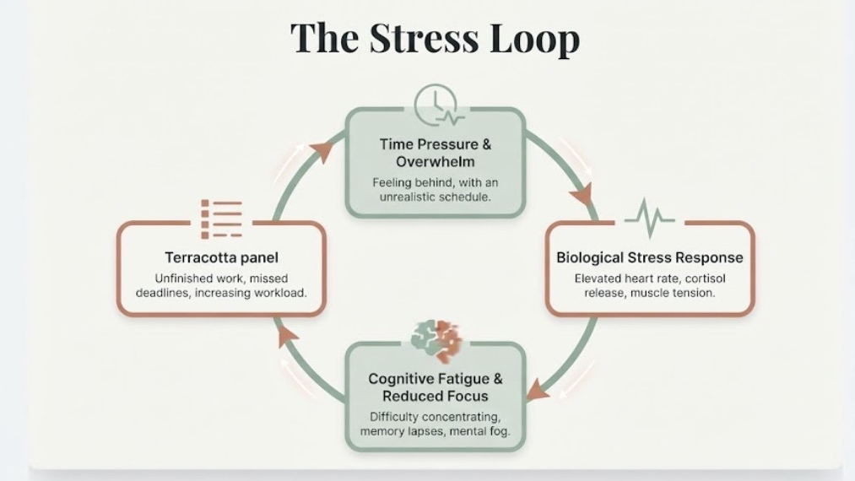

Slide 6

The Toll –Cognitive & Performance Cost
The hidden tax of chronic time pressure on human performance and mental well-being.
  Shift from “I am bad at time management” to “My Brain is paying measurable tax for operating without margins”.
  3 Pillars of the “The Toll”
  1. Cognitive Tax
  2. Physiological Strain
  3. Operational and Relational

Slide 7

Cognitive Tax: (The Brain)
Executive Function Depletion: Working Memory Shrinks under high cortisol, making simple decision-making feel exhausting.
Task-Switching Penalty (Attention Residue): Leaving a task unfinished to handle a quick interruption leaves a fragment of your attention behind, cutting cognitive throughout by up to 40%.
Loss of Strategic Horizon: The brain trades long-term planning, creativity, and problem-solving for immediate short-term survival.

Slide 8

Physiological Strain (The Body)
Sustained Sympathetic Activation: Staying in “fight-or-flight” prevents the parasympathetic nervous system (“rest and digest”) from initiating physical recovery.
Chronic Fatigue & Brain Fog: Nervous system over-arousal burns through glucose and glycogen reserves, causing the 2 pm energy slump and mental exhaustion.
Somatic Indicators: Unconscious breath-holding (“email apnea”), jaw clenching, elevated heart rate, and chronic muscle tension.

Slide 9

Operational & Relational Cost (The Work)
Priority Flattening: Everything feels equally urgent, resulting in superficial output and missed strategic priorities.
Irritability & Conflict: Lower emotional regulation leads to friction in team collaboration and personal relationships.
Burnout & Disengagement: Prolonged operational stress leads to detachment, cynical detachment and eventual physical collapse.

Slide 10
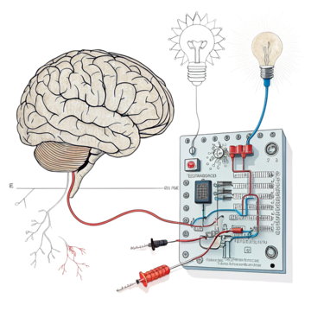
The Circuit Breaker –The Disrupter
Phase
The Stress Trigger
Action Step
The 60-Second Circuit Breaker

Slide 11
Executive Cheat Sheet
Phase | Stress Trigger | 60-Second Circuit Breaker | Action Step
Pressure | Time Urgency & Overwhelm | The 3-Item Audit | Drop/Defer all except 1 non-negotiable task for 90 minutes
Biology | High Heart Rate & Cortisol | Physiological Sigh | 2 Quick inhales through nose, 1 long slow exhale
Focus | Brain Fog & Attention Residue | 5-Minute Brain Dump | Write open loops down on paper to clear RAM
Backlog | Mountain of Unfinished Work | Micro-Slicing | Break large task down into a single 5-minute entry step

Slide 12

Become the Designer of Your Day –Tenant vs. Architect
The Calendar Tenant (Reactive)
You move into whatever schedule others build for you. You live in your inbox, react to incoming pings and fight fires all day.
The Day Designer (Proactive)
You set structural boundaries, protect focus windows, and decide before the day starts where your energy will go.

Slide 13

The 3 Design Principles
Designate before you Decorate (Priority First)
Built Structural Margins (Buffer Time)
Establish Intentional Office Hours (Batching)

Slide 14

Designate Before you Decorate (Priorities First)
The Concept: Before you open your calendar to others or check incoming demands, schedule your primary focus block first. “Decorating” is responding to emails, chat messages, and admin requests; “designating” is securing your non-negotiables.
The Action: Block out your top priority –your 60-90-minute- deep work block at the start of your day or week before opening communication channels.

Slide 15

Build Structural Margins (Buffer Time)
The Concept: Operating a schedule at 100% back-to-back capacity creates constant micro-urgencies and deprives your nervous system of necessary recovery time. Margins are non-assigned buffer zones built to absorb unexpected delays and reset cognitive focus.
The Action: Schedule 10-15- minute unassigned gaps between major meetings or deep focus blocks rather than booking back-to-back commitments.

Slide 16

Establish Intentional Office Hours (Batching)
The Concept: Scattershot communication throughout the day causes constant task-switching and attention residue. Batching reactive tasks into designated windows protects your flow state and establishes clear boundaries.
The Action: Set dedicated 30-minute windows (e.g., late morning and end-of-day) to process inbox messages, team chats, and administrative follow-ups in a single focused bursts

Slide 17

Build Your Daily Focus Toolkit

Slide 18
Operational Tools
1. TIME TOOL
The Focus WIndow
2. ENVIRONMENT TOOL
Friction Control
3. ATTENTION TOOL
Open-Loop Dump

Slide 19

Time Tool: The 90-Minute Sprint
The Tool: Block one non-negotiable 60-90-minute window each day for high-cognition work
The Rule: No email, no Slack/Teams, no open tabs
The Physiology: Alignment with Ultradian Rhythm

Slide 20

Environment Tool: Strategic Friction
The Tool: Increase physical or digital friction for distractions, while decreasing friction for focus.
The Application: Turn off Non-essential notifications, place phone in another room or face-down, and keep your workspace clutter free.
The Rule: If it takes 3 extra steps to access a distraction, your brain defaults back to the task at hand.

Slide 21

Attention Tool: The External Brain (RAM Clearing)
The Tool: Keep a physical notepad or digital “Parking Lot” file next to your during deep work block.
The Application: When an intrusive thought or non-urgent task pops up (“Remember to send that invoice”), write it down immediately and return to deep focus.
The Value: Prevents attention residue without losing track of important tasks.

Slide 22
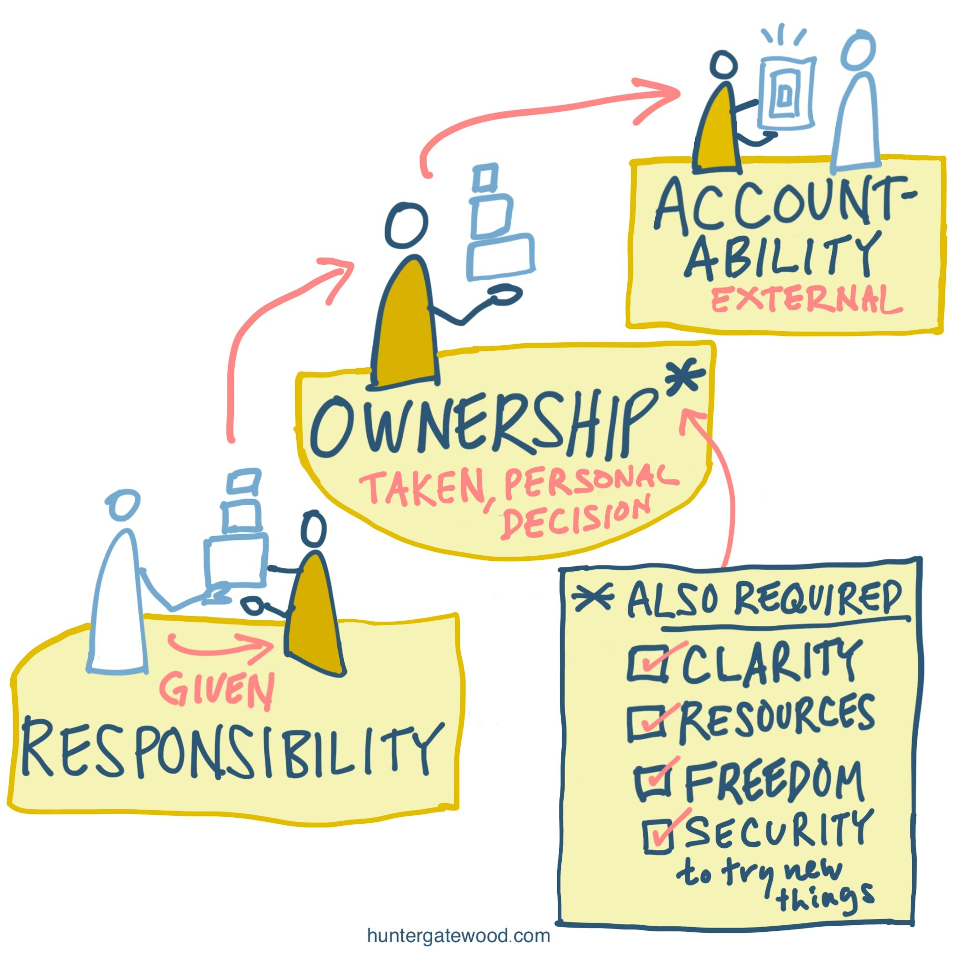
Reclaiming Ownership: Mastering Mind & Time
The Mindset Shift: Time management isn’t about fitting more work into your day; it’s about creating space for what keeps you healthy, creative, and fully present.
The Key Realization: When you control your calendar, you protect your nervous system.

Slide 23
The 3 Master Steps
DEFEND YOUR MARGINS
Space to Breathe
CLOSE THE OPEN LOOPS
Shutdown Ritual
REGULATE TO PERFORM
Energy Over Hours

Slide 24

Defend Your Margins (Space to Breathe)
The Rule: Treat blank space on your calendar with the same respect as meeting with a client.
The Application: Schedule 10-minute “Buffer Zones” to decompress between focus blocks.
  Margin is where stress releases and creative clarity lives.

Slide 25

Close the Open Loops (The Shutdown Ritual)
The Tool: A 5-Minute End-of-Day Shutdown Routine.
The Application: Clear your working memory, log unfinished items for tomorrow, and signal to your brain that the workday is officially over.
The Result: Keeps work stress from bleeding into your evening and home life.

Slide 26

Regulate to Perform (Energy Over Hours)
The Principle: You don’t manage time –you manage energy.
The Application: Use micro-resets (somatic deep breaths, physical movement, stepping outside) throughout the day to keep your biological engine out of the redline.

Slide 27

The Bottom Line
1. Interrupt the Stress Loop
2. Be the Designer of Your Day
3. Lock Your Focus & Close the Loop

Slide 28


Please Feel Free to Contact Me

Slide 29


Review of Your TELUS Health Benefits

Slide 30
State of Alabama: EAP Benefits
Employees and dependents may receive up to five (5) visits/consults
at no charge each plan year.

Slide 33

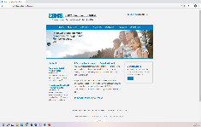
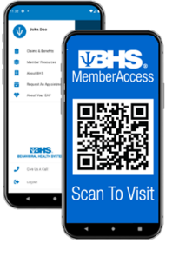

Digital Resources: TELUS Health MemberAccess
www.memberaccess.behavioralhealthsystems.com
TELUS Health MemberAccess in your App Store
  Work/Life ASSIST & EASE (NEW BENEFIT!)
  Benefit information including digital wallet card
  Appointment requests & forms
  Self-assessment tools
Two ways to login:
  Use your Employer ID: DORM
  Create a Unique User Login

Slide 34



Accessing the TELUS Health Benefits
Begins with a call: 800-245-1150 or visit
MemberAccess.BehavioralHealthSystems.com
Designated Care Coordinator is available Monday-Friday: 7:00-5:00 CT / 8:00-6:00 ET
After-hour, weekend and holiday calls answered by mental health professionals – never an automated response system
Digital offerings also available via the TELUS Health MemberAccess app and portal
  To log in, use your Employer ID: DORM
Stormi White
MS, LMSW

Slide 35

A Personalized Approach To Behavioral Health
Behavioral health
EAP
& Work/life
Drug testing
Telehealth
& digital

