Slide 1
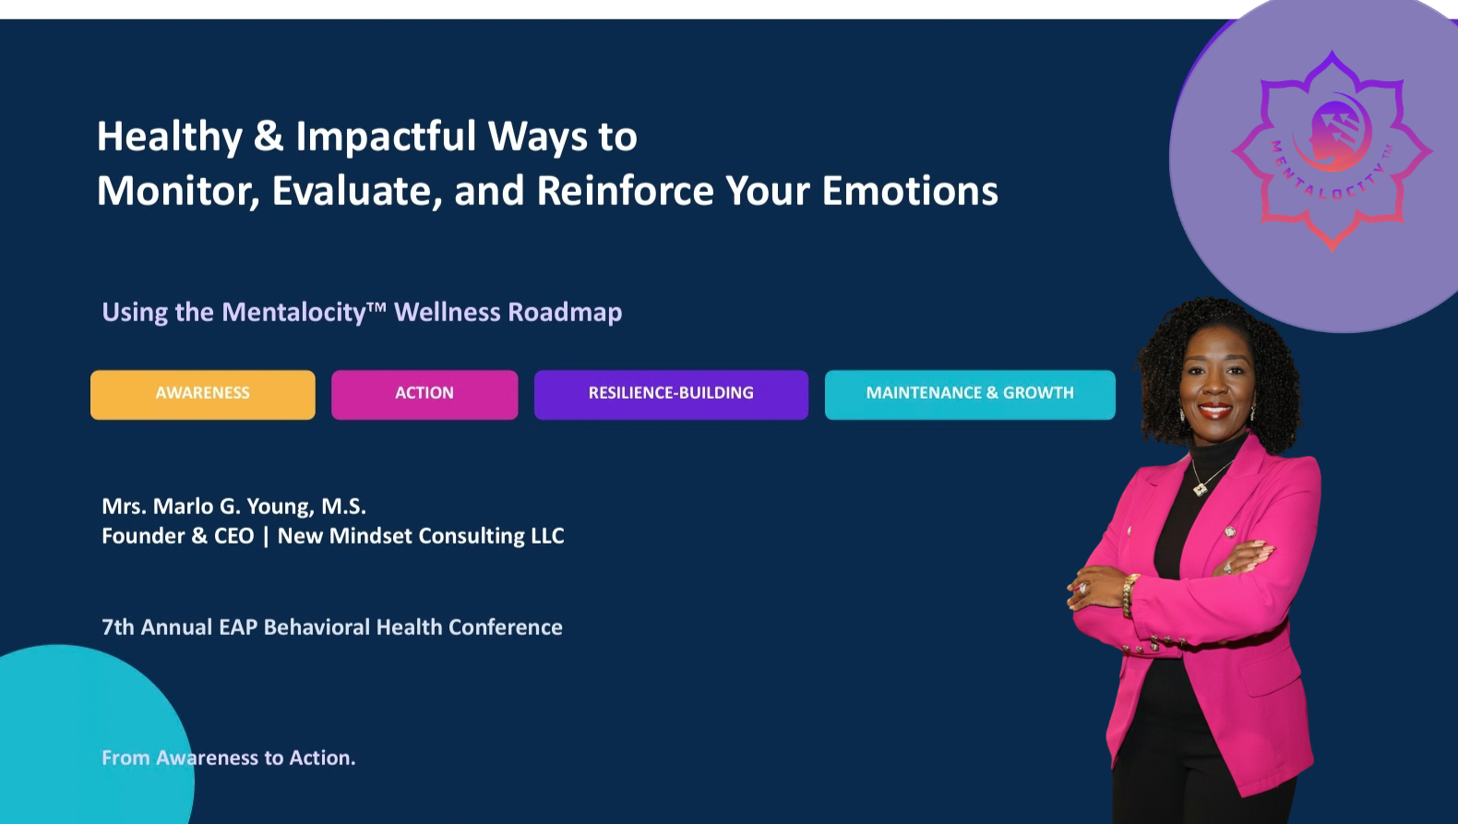
Notes:
“We experience emotions all day long, but how often do we actually stop long enough to understand what they are telling us? Today isn't about eliminating difficult emotions. It's about learning how to recognize them, respond to them intentionally, and build healthier patterns over time.”

Slide 2
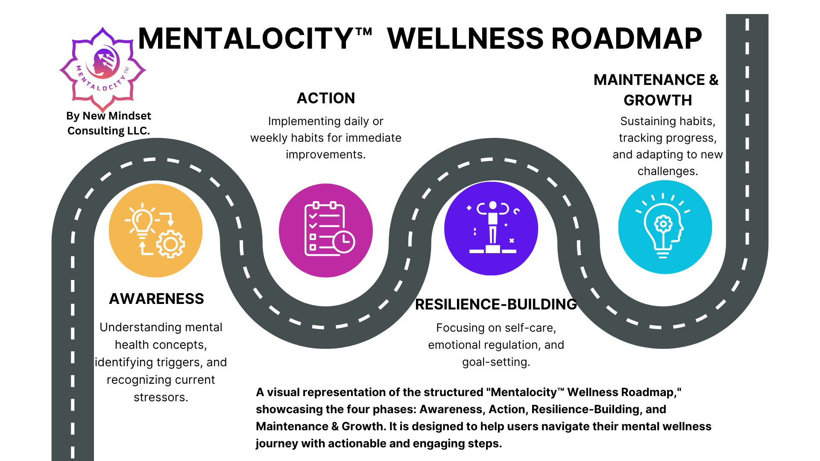
Notes:
Briefly introduce the Mentalocity™ Wellness Roadmap as the framework participants will use throughout the session.

Slide 3
ROADMAP
Today's Mental Wellness Journey
A practical path from recognizing emotions to reinforcing healthier patterns.
1
2
3
4
AWARENESS
ACTION
RESILIENCE-BUILDING
MAINTENANCE & GROWTH
What am I feeling?
→
What is this emotion telling me?
→
What healthy response can I practice?
→
How do I reinforce what works?
MONITOR → EVALUATE → RESPOND → REINFORCE
MENTALOCITY™ | From Awareness to Action
Notes:
framework describes this journey as moving from recognizing emotions toward intentionally managing them and building resilience.
“Mental wellness isn't a destination. It's a journey. And just like traveling somewhere unfamiliar, it helps to have a roadmap.”
Explain the connection:
Awareness: What am I feeling?
Action: What is this emotion telling me, and what will I do?
Resilience-Building: What healthy response can I practice?
Maintenance & Growth: How do I reinforce what works?
Then say:
“Those four questions will guide everything we do for the next 30 minutes.”

Slide 4
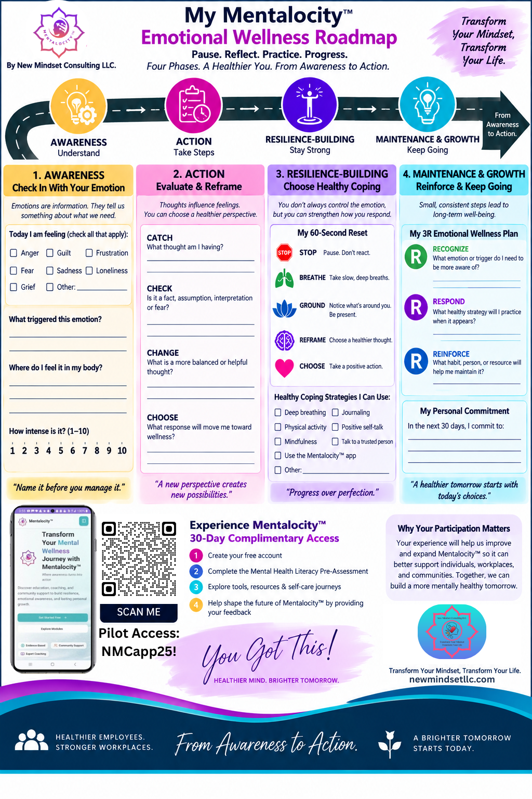
OBJECTIVES
Learning Objectives
By the end of this session, participants will be able to:
1 MONITOR — Awareness
Identify emotional triggers, stressors, and behavioral patterns and recognize their influence on thoughts, decisions, relationships,
and well-being.
2 EVALUATE & RESPOND — Action + Resilience
Apply practical strategies to evaluate and regulate emotional responses through reflection, reframing, healthy coping, and intentional wellness practices.
3 REINFORCE — Maintenance & Growth
Develop a personalized strategy for reinforcing healthy emotional habits, tracking progress, and utilizing EAP and other support resources.
MENTALOCITY™ | From Awareness to Action

Slide 5
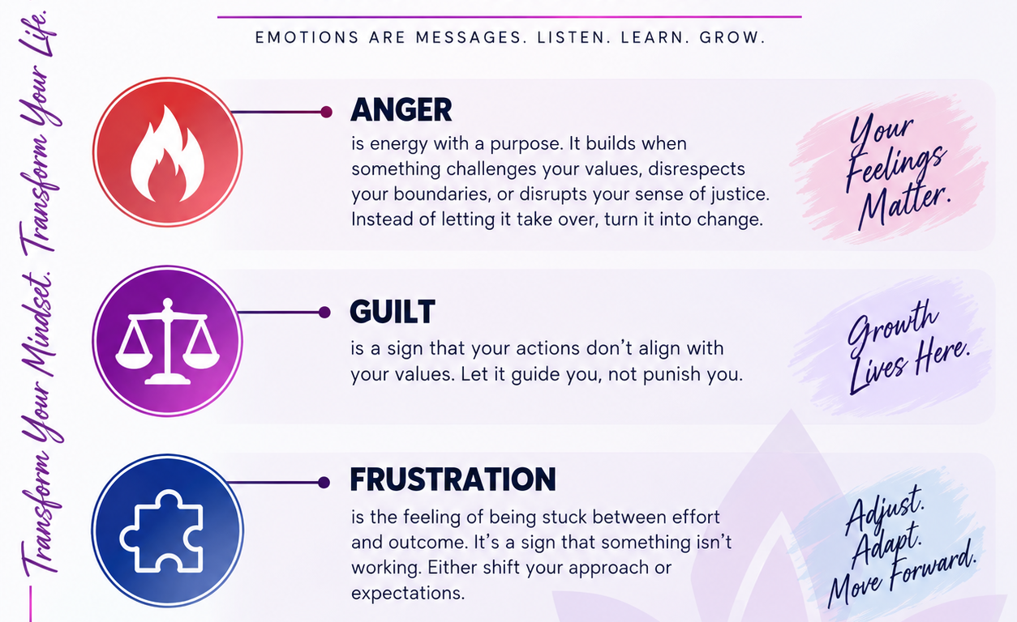
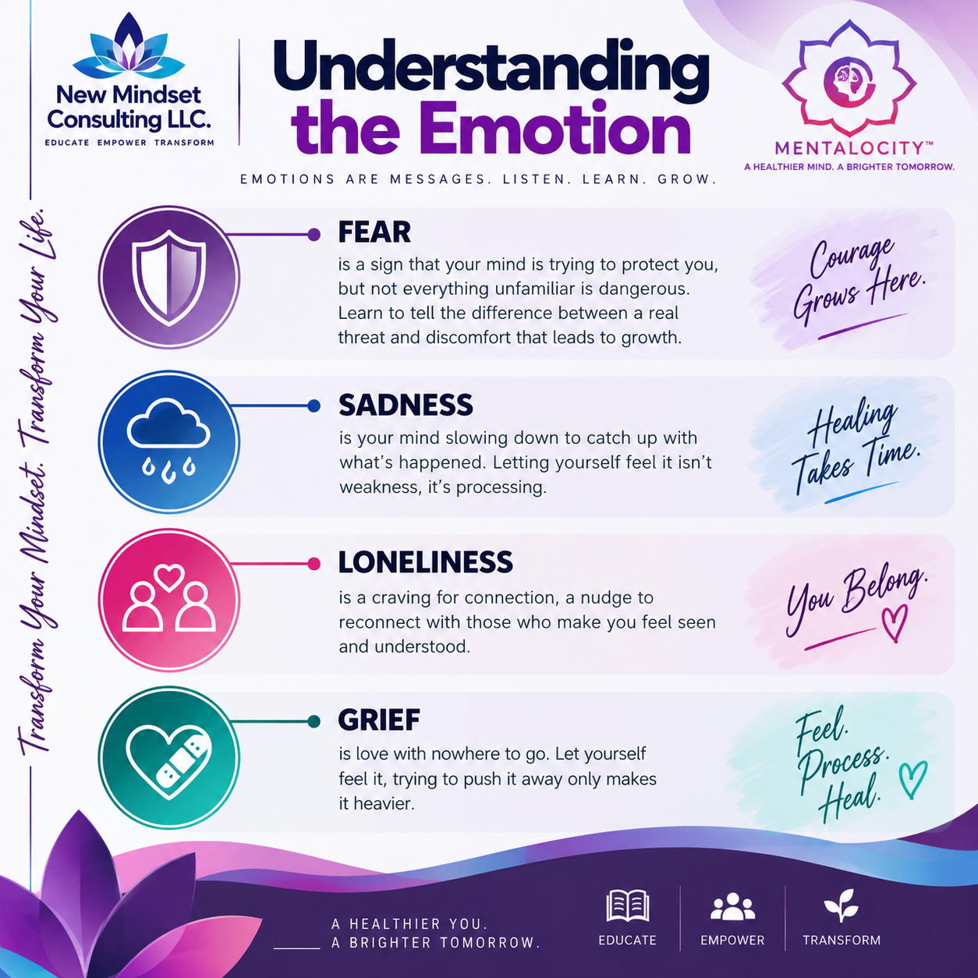
AWARENESS
Name It Before You Manage It
Emotions are information. They do not automatically have to become instructions.
REFLECT
Which emotion is easiest for you to recognize?
Which one tends to sneak up on you?
MENTALOCITY™ | From Awareness to Action
Notes:
“Anger may tell us a boundary has been crossed. Frustration can tell us that our current approach isn't producing the desired result. Fear may signal perceived danger or uncertainty. Loneliness can alert us to our need for connection.”
Then make an important distinction:
“Understanding an emotion does not mean every reaction that follows it is healthy. The emotion gives us information; we still choose the response.”
Ask the audience:
“Which emotion is easiest for you to recognize—and which one tends to sneak up on you?”

Slide 6
AWARENESS
The Emotional Check-In
Monitoring is curiosity, not judgment.
1
2
3
4
PAUSE
NOTICE
NAME
RATE
Create a moment of space.
What is happening in your body?
What emotion is present?
How intense is it, 1–10?
2-Minute Mentalocity™ Check-In
Emotion: __________ Trigger: __________ Intensity: ___ / 10 Where do I notice it in my body? ____________________
Think of a recent everyday situation — not your most traumatic or distressing experience.
MENTALOCITY™ | From Awareness to Action
Notes:
“Monitoring isn't judging yourself. Monitoring means becoming curious enough to notice what's happening before automatically reacting.”

Slide 7
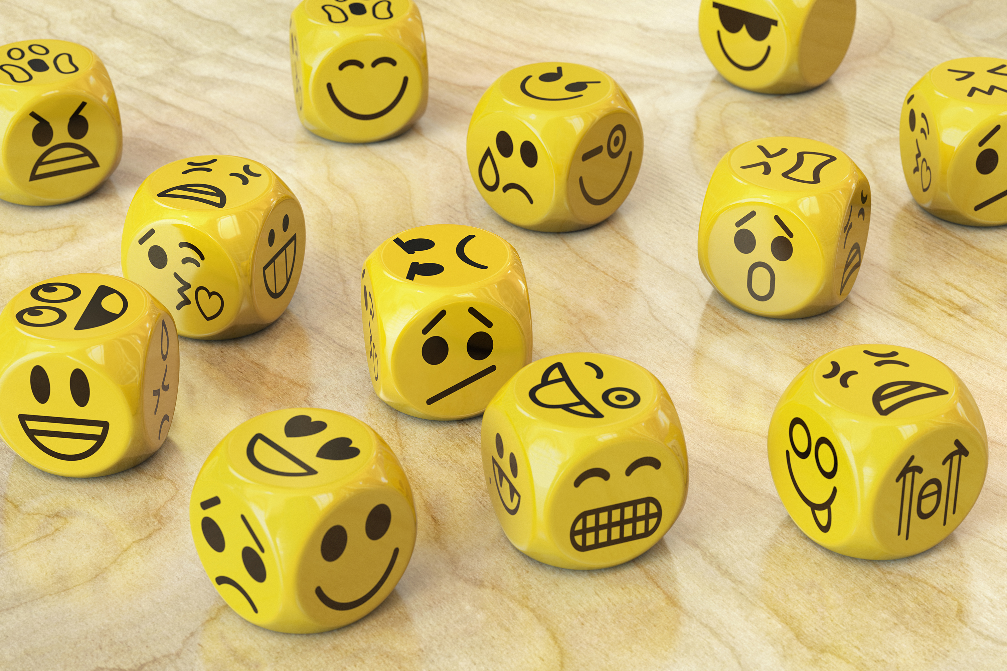
ACTION
What Is My Emotion Telling Me?
Move from automatic reaction to intentional response.
1
What happened?
2
What am I feeling?
3
What am I telling myself about what happened?
4
What response will move me toward — not away from — wellness?
Emotion → Thought → Reaction
Emotion → Pause → Evaluate → Intentional Response
MENTALOCITY™ | From Awareness to Action
Notes:
Give a workplace example:
“Imagine receiving an email that simply says, ‘Can you stop by my office?’ Your body may respond before you know why. Anxiety increases. Your thoughts start filling in the blanks: ‘What did I do?’ But what do we actually know? Only that someone asked us to stop by.”
Emphasize:
“A feeling can be valid without every thought attached to that feeling being accurate.”

Slide 8
ACTION
Mentalocity™ Reframe Tool
A feeling can be valid without every thought attached to it being accurate.
CATCH
CHECK
CHANGE
CHOOSE
What thought am I having?
Is it a fact, assumption, interpretation, or fear?
Is there a healthier or more balanced way to view this?
What response aligns with my values and well-being?
Mini Scenario
“My supervisor hasn’t responded to my email.” Automatic thought: “They’re upset with me.”
What else could be true?
MENTALOCITY™ | From Awareness to Action
Notes:
What else could be true?
Then connect this to the Mentalocity™ reframe feature.

Slide 9
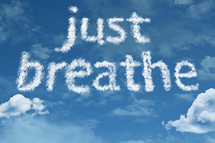
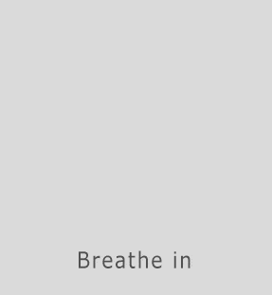
RESILIENCE-BUILDING
Create Space Between Feeling & Response
You may not control the first emotion — but you can strengthen what happens next.
1
STOP
Pause. Don't immediately react.
2
BREATHE
Slow the physiological response.
3
GROUND
Notice what is happening now.
4
REFRAME
Challenge the automatic thought.
5
CHOOSE
Make an intentional response.
60-SECOND RESET
MENTALOCITY™ | From Awareness to Action
Notes:
Lead them through a brief breathing exercise.
“Put both feet on the floor if that's comfortable. Relax your shoulders. Take a slow breath in…and slowly breathe out.”
Then:
“The goal isn't to pretend you're no longer frustrated, angry, anxious, or overwhelmed. The goal is to create enough space between the emotion and the behavior to make a healthier choice.”
Connect this to Mentalocity™ tools such as the breathing coach, affirmations, reframing, boundaries, and self-care journeys.

Slide 10
RESILIENCE-BUILDING
From Reaction to Resilience
Resilience is built through repetition — not perfection.
TRIGGER
→
EMOTION
→
PAUSE
→
HEALTHY
RESPONSE
→
REFLECTION
→
GROWTH
Practice self-care. Regulate. Reflect. Adjust. Repeat.
MENTALOCITY™ | From Awareness to Action
Notes:
Explain that resilience isn't simply “bouncing back.” In the context of your roadmap, it involves intentionally practicing self-care, emotional regulation, and goal-directed behavior.

Slide 11
MAINTENANCE & GROWTH
The 3R Emotional Wellness Plan
What will I keep doing?
RECOGNIZE
RESPOND
REINFORCE
What emotion or trigger do I need to become more aware of?
What healthy strategy will I practice when it appears?
What habit, person, resource, or support will help me maintain it?
My Commitment
When I notice __________, instead of automatically __________, I will practice __________.
One resource/person I can reach out to is ______________________________.
MENTALOCITY™ | From Awareness to Action
Notes:
This becomes their takeaway commitment.
Your existing objective already emphasizes creating an emotional wellness action plan, tracking progress, and utilizing EAP resources, so this activity directly demonstrates that objective rather than merely talking about it.

Slide 12

SUPPORT
Your Support System Is Part of the Roadmap
Self-management does not mean self-isolation.
1
Employee Assistance Program
Know your organization's benefits and access process.
2
Mental Health Professionals
Therapy, counseling, and behavioral health support.
3
Primary Care Providers
Whole-person health and appropriate referrals.
4
Trusted People & Community
Family, friends, peers, faith/community supports.
5
988 Suicide & Crisis Lifeline
Call, text, or chat 988 when crisis support is needed.
MENTALOCITY™ | From Awareness to Action
Notes:
This is where you can reinforce an important EAP message:
“Self-management doesn't mean self-isolation. Knowing when and where to seek support is itself a healthy coping skill.”
Encourage attendees to know their organization's specific EAP benefits and access process.

Slide 13
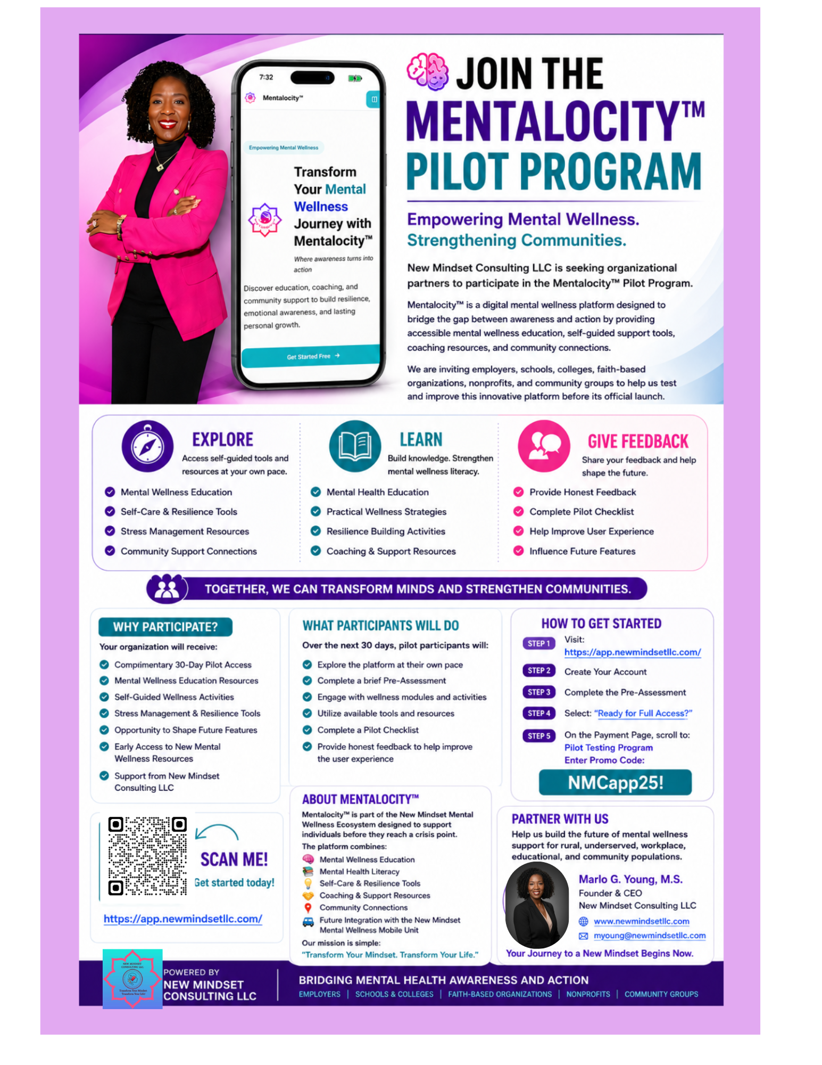
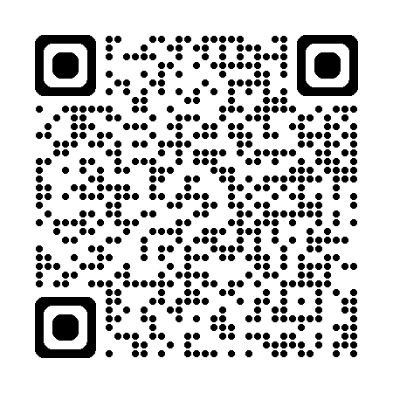
EXPERIENCE MENTALOCITY™
Take the Journey With Us
30-Day Complimentary Access — explore, practice, and help shape the tool.
1
SCAN
Access Mentalocity™
2
ASSESS
Complete the Mental Health Literacy Pre-Assessment
3
EXPLORE
Use check-ins, literacy content, breathing and reframing tools
4
PRACTICE
Apply the Wellness Roadmap over 30 days
5
FEEDBACK
Tell us what helped and what should improve
Pilot Access Code:
NMCapp25!
https://app.newmindsetllc.com/
MENTALOCITY™ | From Awareness to Action
Notes:
“I'm inviting you to do more than hear about the Mentalocity™ Wellness Roadmap today. I'm offering you 30 days to experience it. You'll begin with a brief mental health literacy pre-assessment, explore the platform, use the tools that are meaningful to you, and provide feedback. Your experience will help us learn what works, what's useful, and what needs to improve as we continue developing Mentalocity™.

Slide 14

Your Mental Wellness Journey Continues
AWARENESS → ACTION → RESILIENCE-BUILDING → MAINTENANCE & GROWTH
MONITOR → EVALUATE → RESPOND → REINFORCE
Awareness tells us where we are.
Action determines our next step.
Resilience helps us keep moving.
Maintenance & Growth turn healthy responses
into healthier patterns.
You don't have to master every emotion. Practice becoming more aware, intentional, and consistent.
FROM AWARENESS TO ACTION.
Notes:
“You don't have to master every emotion. The goal is to become more aware of what you're experiencing, more intentional about how you respond, and more consistent about reinforcing what supports your well-being.”
Then return to your New Mindset message:
“From Awareness to Action.”

