Slide 1

The Power of Positivity: Cultivating a Healthy Mindset
Date

Slide 2
State Employee Assistance Program
This presentation is part of the services provided by the State Employee Assistance Program through Behavioral Health Systems, Inc. The State EAP is administered and managed by the State Department of Finance’s Division of Risk Management (DORM). If you have questions regarding the policy, procedures or services provided by this program, please contact the Program Coordinator, Kwatasian Hunt, at kwatasian.hunt@finance.alabama.gov. You can also find more information about the State Employee Assistance Program on the Division of Risk Management’s website at www.riskmgt.alabama.gov.
Notes:
IMPORTANT PLEASE READ

Slide 3
Objectives
Define what is a positive attitude
Learn how to cultivate a positive mindset
Discover how to limit negativity and increase positive self-talk
Explore the three pillars of respect in the workplace and how they affect a positive workplace
Review State of Alabama’s EAP benefits

Slide 4
Positivity
The practice of being or tendency to be positive or optimistic in attitude
It is an attitude that helps you see the good in people
It is a mental attitude that sees the good and the accomplishments in your life, rather than the negative and the failure
It is optimism and maintaining a positive mindset

Slide 5
Positivity
Several studies have shown that happy people tend to have an overall more positive and optimistic outlook on life, while less happy people tend to view things in a more negative and pessimistic light.
“Perception”

Slide 6
Perception
Bad things happen in the world. We all probably feel like our lives are especially hard or unfair sometimes and we feel like we have reason to be negative at times. However, something we often forget is that regardless of what happens, we always have a choice as to how we respond, and we can always choose to focus on the positive aspects instead of the negative ones.

Slide 7
Reasons to be Positive

Slide 8
Reasons to be Positive
Being positive enables us to build new skills
  Research has shown that people who are positive are more productive and able to identify more possible responses and solutions than people in a neutral or negative state of mind
  Research has shown that people in a positive state of mind have an enhanced ability to build skills and develop resources that will still be useful later in life after the momentary positive emotion has passed

Slide 9
Reasons to be Positive
A positive mindset helps us earn more
  Research suggests that a positive attitude has a direct effect on wage
  For those of you who are career-focused and who are striving for financial goals, research has shown that in order to raise our earning potential we should not only focus on the development of skills but also the development of a positive attitude

Slide 10
Reasons to be Positive
Positivity can help us live longer
  Positivity has been linked to higher life expectancy and might help protect from onsets of dementia
  Having a positive attitude has been known to improve interpersonal relationships; cultivating relationships with family, friends and neighbors helps us live longer, happier lives
  Positive people are simply not as “stressed out;” reducing negative consequences of stress

Slide 11
Ways to Stay Positive

Slide 12
Connect with Others
Creating Connections
  Connection happens when you get:
      Concrete help, such as having a friend pick your kids up school
      Emotional support, like someone saying, “I’m sorry for your loss”
      Perspective, like being reminded that babies eventually become adults
      Advice, such as a suggestion for nice dinner restaurant
      Validation, like learning that other people need help too

Slide 13
Connect with Others
Do you have enough support?
  Do you have a few family or friends who:
      You feel comfortable to be with
      You feel you could tell them anything
      You feel can help you solve problems
      Make you feel valued
      Take your concerns seriously

Slide 14
Connect with Others
Making Friends
  If your current connections don’t provide enough support, consider:
      Enrolling in a new class
      Joining a book club, hiking club, or interest group
      Volunteering for a specific cause that interests you
      Reaching out to previous connections with whom you have lost contact

Slide 15
Connect with Others
Strengthening Your Relationships
  If you want to get more out of the relationships you have, consider:
      Make reminders to contact certain people regularly
      Commit a certain amount of time to spend with friends/family each week
      Listen to others
      Ask for help when needed
      Show gratitude to friends/family
      Discontinue relationships in which you feel unsafe, that lower your self-esteem, or lead to unhealthy habits

Slide 16
Connect with Others
Getting Support from a Group
  If you are experiencing a serious illness or particular stress, you may consider additional support. Support groups can provide:
      Concrete suggestions and information about the issue
      People who can empathize with how you are feeling
      A reminder that you are not alone
      Inspiration from seeing others coping

Slide 17
Stay Positive
Foster Optimism
  Focus on the positive as much as possible
      Write about a positive future
        The idea is to envision your goals and dreams come true
      Search for the silver lining
        Look for the positive in the negative situation

Slide 18
Stay Positive
Practice Gratitude
  To increase your gratefulness, you can:
      Write a gratitude letter
      Keep a gratitude journal
      Remind yourself to live in the moment
      Share your good news

Slide 19
Stay Positive
Avoid Negative Thinking
  In order to feel positive, decrease downers in your life
      Avoid dwelling on downers
      Change unhealthy self –talk
      Ask yourself if the negative thought is really true
      Remember any achievements that disprove your insecurity
      Imagine what you would tell a friend
      Beware of all or nothing thinking
      Consider alternative explanations

Slide 20
Get Moving
How Exercise Helps
  Regular exercise can:
      Prevent heart disease and high blood pressure
      Lower your risk for stroke, osteoporosis, colon cancer and diabetes
      Improve your sleep
      Increase your energy
      Boost your immune system
      Decrease some kinds of pain

Slide 21
Get Moving
Exercise Matters for Your Mood
  Exercise helps by:
      Decreasing stress, anger and tension
      Reducing anxiety and depression
      Offering a greater sense of well being
      Stimulating feel-good hormones
      Increasing blood flow to the brain

Slide 22
Get Enough Sleep
How Sleep Helps
  Research shows that you are more likely to succeed at your tasks and enjoy greater well being if you get sleep
  Nearly two-thirds of Americans say they lose sleep because of stress
  Poor sleep has been linked to significant problems, including:
      greater risk of depression and anxiety
      increased risk of heart disease and cancer
      greater likelihood of accidents

Slide 23
Get Enough Sleep
Are You Getting Enough Rest?
  To assess your sleep deficit, ask yourself:
      Am I often tired?
      Am I using caffeine to get through the day?
      Do I sleep well?
      Do I wake up feeling refreshed?
      Do I get drowsy while driving or watching TV?

Slide 24
Get Enough Sleep
Tips for Better Sleeping
  To sleep longer and better consider:
      Set a regular bedtime
      De-caffeinate yourself
      De-stress yourself
      Exercise
      Make your bed a sleep haven

Slide 25
Positive Self-Talk and Positive Thinking

Slide 26
Positive Thinking
Is your glass half-empty or half-full?
  How you answer this question will frame the way you think about our discussion today and what you take away from it
Positive thinking is often associated with optimism

Slide 27
Optimism vs. Pessimism
Research shows that optimists live longer, more fulfilling lives
  Researchers at University of Pittsburgh looked at rates of death and chronic health conditions among women
      Women who were optimistic — those who expect good rather than bad things to happen — were 14% less likely to die from any cause when compared to pessimists
      They were also 30% less likely to die from heart disease after 8 years of follow up in the study

Slide 28
Optimism vs. Pessimism
Are you an optimist or a pessimist?
Optimists:
  See setbacks as temporary (I didn’t get an A on that project, but I can get an A in the future), isolated (I just had a bad day) and external. They remain hopeful and confident, despite the odds
Pessimists:
  See adversity as permanent (it happened once, it will happen again), pervasive (I made a mistake so my whole day is ruined) and personal (it’s all my fault)

Slide 29
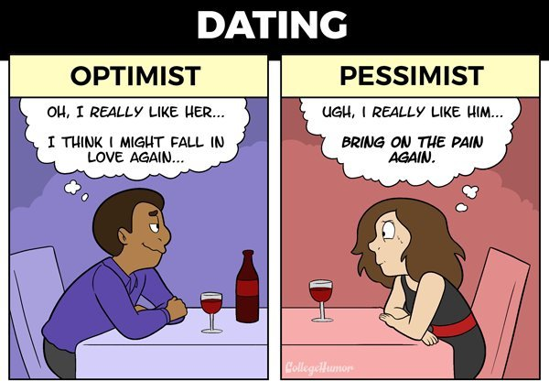
Optimism vs. Pessimism

Slide 30
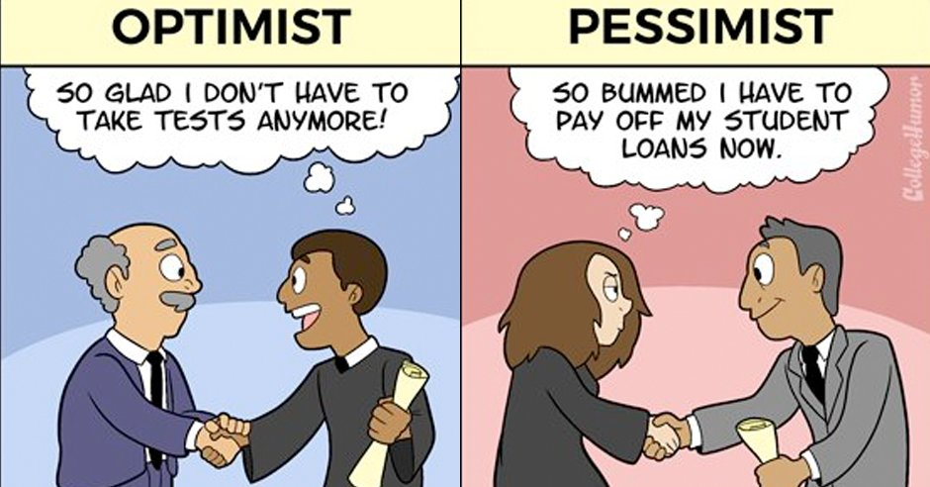
Optimism vs. Pessimism

Slide 31
Positive Thinking & Self-Talk
Positive thinking means that you approach life’s unpleasant situations in a more positive and productive way
You think the best CAN happen, not that the worst WILL happen
Positive thinking often starts with self-talk
Self-talk is the endless stream of unspoken words that you tell yourself
These automatic thoughts can be positive or negative

Slide 32
Positive Thinking & Self-Talk
You can reframe your self-talk if you notice that it is not as you want it to be
“I started the day by waking up late, the dog had an accident and I had a flat tire on the way to work”
Positive self-talk: “Although the day hasn’t started as I wanted it to, I can start fresh by walking into work and clearing my head”
Negative self-talk: “It isn’t my day. I’m going to call in sick and stay in bed”

Slide 33
Positive Thinking & Stress Management
Personality traits, such as optimism and pessimism, can affect many areas of your health and well-being
When we think of someone in our lives who is POSITIVE, we usually see them as someone with low stress or someone who is able to manage the stressful times well
Positive thinking doesn’t just mean ignoring life’s tough challenges or running away from it all

Slide 34
Putting Positive Thinking Into Practice
Negative Self-Talk
I’ve never done it before
It’s too complicated
I don’t have the resources
It’s too radical a change
No one communicates with me
Positive Thinking
It’s a new opportunity
I’ll tackle it differently
How can I get it done
Let’s do something different, take a chance
I’ll see if I can open the channels of communication

Slide 35

The Power of Positivity
“Being positive won’t guarantee that you will succeed. But, being negative will guarantee you won’t.”
- Jon Gordon

Slide 36
Pillars of Respect

Slide 37
Pillars of Respect in A Positive Workplace
In the book, Making Work Work: The Positivity Solution for Any Work Environment, Shola Richards offers solutions for creating a more positive and professional workplace by using kindness and mutual respect
His personal journey started a movement around positivity following a painful period in his professional life
After 2 years working for a boss who told him his name was “too complicated and weird,” the boss told him to refer to himself as “Steve” at work

Slide 38
Pillars of Respect in A Positive Workplace
Two years later, he quit and authored the book that we’ll discuss today
Richards outlines three pillars of respect that must be practiced to create a positive workplace. They include:
  Respectful communication
  Respect for the individual
  Respect for the team

Slide 39
Pillar #1: Respectful Communication
Respectful communication is communicating verbally and nonverbally in a manner that shows openness, and is free from judgment and includes common courtesy
  Say hello. It seems simple, but it is shocking how many leaders fail to do so. Saying hello is a way of genuinely acknowledging others
  Keep language appropriate; avoid swearing
  Be polite, calm, well-spoken, confident, but not arrogant
  Avoid jokes about co-workers and/or customers
  Treat others the way you would like to be treated

Slide 40
Examples: Inappropriate Communication
Making negative comments about an employee's personal religious beliefs, or trying to convert them to a certain religious ideology | Making offensive reference to an individual's mental or physical disability
Using racist slang, phrases or nicknames | Sharing inappropriate images, videos, e-mails, letters or notes in an offensive nature
Making remarks about an individual's skin color or other ethnic traits | Offensively talking about negative racial, ethnic or religious stereotypes
Making offensive gestures | Making derogatory age-related comments
SOURCE: THE BALANCE

Slide 41
Pillar #2: Respect for the Individual
Never give critical feedback in front of others. Be quick to apologize and own your mistakes. Offer solutions to issues
  Do not speak with offensive language (as judged by those around you) and unfiltered comments
  Focus on your behavior, not your co-workers’ or other employees’
  Provide follow-through and respond promptly to issues and requests
  Don’t tolerate bullying—speak up

Slide 42
Stop Gossip in its Tracks
In any workplace, gossip is a dangerous element that has no place
It destroys an atmosphere of respect and trust that is essential
Remember the Telephone Game from school? Once a story about someone begins to spread, it changes each time it is told
Think of how you would feel if someone shared your personal information

Slide 43
Pillar #3: Respect for the Team
Offer support to employees and colleagues without being asked. Reject cliques or activities that divide the team instead of bringing it together
  Connect on a personal level. You do not have to be everyone’s friend, but allow others to feel like you are a team player, and you are able to encourage the team
  Make sure coworkers and supervisors can talk to you without you having a defensive or negative posture
  Be the manager that you would want to have!

Slide 44

That Which We Feed Grows,
That Which We Starve Dies
Recognize and Reward behaviors that enhance professionalism in the workplace
  This doesn’t have to cost you anything
  People appreciate being thanked, recognized and feeling appreciated
Develop a culture where professionalism is the expectation and norm
Morale will soar when everyone brings their best selves to the workplace

Slide 45
Review of Your BHS Benefits
State of Alabama

Slide 46
About BHS: At a Glance
30+ Years in Business
750,000+ Covered Lives Nationally
87% Client Retention
Employee-Owned
Birmingham, AL Headquarters;
Midwest Regional Office (Chicago)
96% Patient Satisfaction Rate
“Open” Preferred Provider
Network of 25,000+ Providers
3% Staff Turnover Rate
Our mission
To provide comprehensive behavioral health services to employers and their beneficiaries which are high quality, cost effective, uniformly accessible, and managed within a least restrictive treatment approach.

Slide 47




State of Alabama: EAP Benefits
All employees and dependents may receive up to
three (3) visits/consults at no charge each year.
Behavioral
Speak with Counselors
Referrals for mental/ behavioral health & substance abuse issues
Financial
Speak with Advisors
Assistance with budgeting, estate planning, college, debt restructuring, etc.
Eldercare
Speak with Professionals
Help with nursing home & assisted living placement, caregiver issues, etc.
Well-Being
Speak with Work/Life Specialists
Help with stress, emotional health work/life balance, etc.

Slide 48


Accessing the EAP
Begins with a call to BHS: 800-245-1150
BHS Care Coordinator is available Monday-Friday
from 7:00-5:30 CT
Your BHS Care Coordinator will:
Verify personal information to confirm benefit eligibility
Ask a few questions about needs and preferences
Assist in referring to the appropriate counselor or provider
After hour, weekend and holiday calls answered by licensed mental health professionals – never an automated response system

Slide 49



Accessing the EAP
Dedicated BHS Care Coordinator
When you call BHS, you will speak with the BHS Care Coordinator assigned specifically to the State of Alabama
Marie Wilbanks
Care Coordinator
mwilbanks@behavioralhealthsystems.com
BHS Care Coordinators
Caring, knowledgeable, credentialed counseling professionals who have been selected for their commitment to treat everyone with sensitivity, respect and concern

Slide 50

BHS Website:
www.behavioralhealthsystems.com
Access to:
Enhanced Member Section detailing your unique benefits and services (Member Access)
Member Tips & Resources
Self-Assessment Tools
Appointment Requests
Online Work/Life (password: DORM):
Lifestyle tools to support a healthy work/life balance
Extensive library providing access to relevant articles, seminars, self-help information, news items and more

Slide 51
The Power of Positivity: Cultivating a Healthy Mindset
DATE

