Slide 1
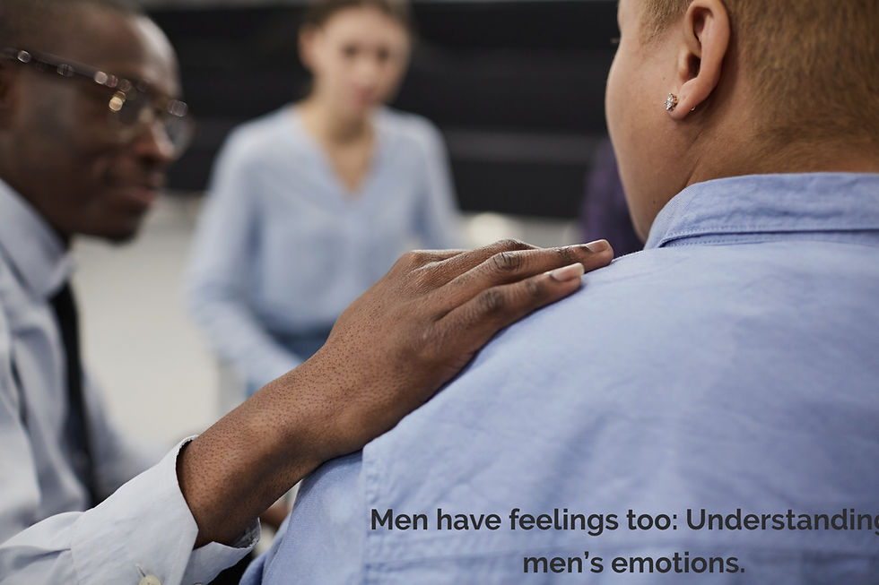


The Forgotten Emotions of Men
Access TELUS Health MemberAccess
Employer ID: DORM
Notes:
I want to begin with a quote that has generated a lot of discussion about the emotional lives of men. Comedian Chris Rock once said, "Only women, children, and dogs are loved unconditionally. A man is only loved under the condition that he provides something."
Whether you agree with that statement or not, it speaks to a belief that many men carry: that their value is tied to what they do, what they achieve, what they earn, or what they provide for others.
Research on masculinity and emotional socialization suggests that many boys grow up receiving messages such as "suck it up," "man up," "boys don't cry," or "stop being a baby." While these messages are often intended to promote resilience, they can also teach boys that certain emotions are unacceptable to express.
Many men learn that anger is permissible, competitiveness is encouraged, and stoicism is respected. But emotions such as hurt, fear, loneliness, grief, disappointment, and vulnerability are often minimized, hidden, or ignored.
The challenge is that emotions do not disappear simply because they are suppressed. They often resurface in other ways—through anger, withdrawal, addiction, workaholism, relationship conflict, anxiety, depression, or emotional numbness.
Today, we're going to explore what I call the forgotten emotions of men. Drawing from the work of Brené Brown, Gabor Maté, Matthias Barker, and Bessel van der Kolk, we'll examine how culture, trauma, shame, and emotional neglect shape men's relationship with their emotions—and what happens when men are finally given permission to feel what they've been taught to hide.

Slide 2
Learning Objectives
By the end of this presentation, participants will be able to:
Recognize how cultural expectations influence men's relationship with emotions.
Identify emotions that are commonly hidden beneath anger, stoicism, and emotional withdrawal.
Understand how emotional awareness contributes to healthier relationships, improved well-being, and personal growth.

Slide 3

State Employee Assistance Program
This presentation is part of the services provided by the State Employee Assistance Program through TELUS Health. The State EAP is administered and managed by the State Department of Finance’s Division of Risk Management (DORM). If you have questions regarding the policy, procedures or services provided by this program, please contact the Program Coordinator, Kwatasian Hunt, at kwatasian.hunt@finance.alabama.gov. You can also find more information about the State Employee Assistance Program on the Division of Risk Management’s website at www.riskmgt.alabama.gov.

Slide 4
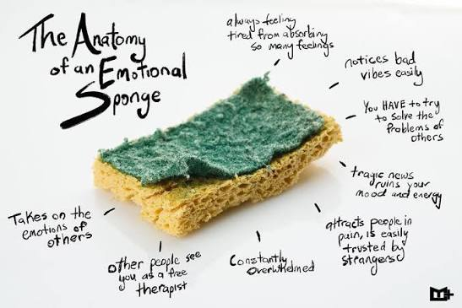
Notes:
Speaker Notes (Word-for-Word Option)
Opening (Before the Sponge Comes Out)
“This isn’t about feelings for the sake of feelings. This is about how repeated exposure affects performance, relationships, and longevity in this job.”
“No graphic stories. Just reality.”
Slide: The Sponge
“This sponge represents emotional capacity — the ability to absorb, hold, and process what life throws at us.”
“Capacity is not toughness. It’s volume.”
Slide: General Public Exposure
(Light pour)
“Most people experience about three to six major traumatic events in their lifetime.”
“Their sponge gets wet — but there’s usually time to dry out.”
Slide: Court Personnel
(Heavy pour)
“In policing, we’re talking hundreds of exposures over a career.”
“This isn’t about being ‘too sensitive.’ It’s exposure frequency.”
Pause. Let them see the saturation.
Slide: When We Don’t Ring It Out
“Here’s the part that gets misunderstood.”
“If we don’t intentionally release stress, the sponge doesn’t stay neutral.”
Slide: The Leak
(Let it drip)
“We don’t usually leak at work.”
“We leak at home. With the people who didn’t sign up for the job.”
Let silence do some work here.
Slide: Capacity, Not Character
“Nothing is wrong with the sponge.”
“It’s doing exactly what it’s designed to do.”
Slide: Ringing It Out
(Squeeze sponge)
“This isn’t dumping everything or breaking down.”
“This is routine maintenance.”
Close
“If the job fills the sponge, recovery is part of the job.”
How to Handle Pushback (This Is Key)
Pushback #1: “I’ve seen worse. I’m fine.”
Response:
“I don’t doubt your toughness.”
“This isn’t about whether you can carry it — it’s about what it costs over time.”
Pushback #2: “This sounds like therapy.”
Response:
“This is physiology and exposure, not therapy.”
“If this were about muscles or joints, we wouldn’t debate it.”
Pushback #3: “I don’t want to talk about my feelings.”
Response:
“Good news — you don’t have to.”
“This is about awareness and maintenance, not confession.”
Optional Final Slide (Highly Recommended)
Title: One Thing to Remember
Text:
You don’t get to choose exposure
You do get to choose release
Say:
“Ignoring the sponge doesn’t make it smaller.”

Slide 5
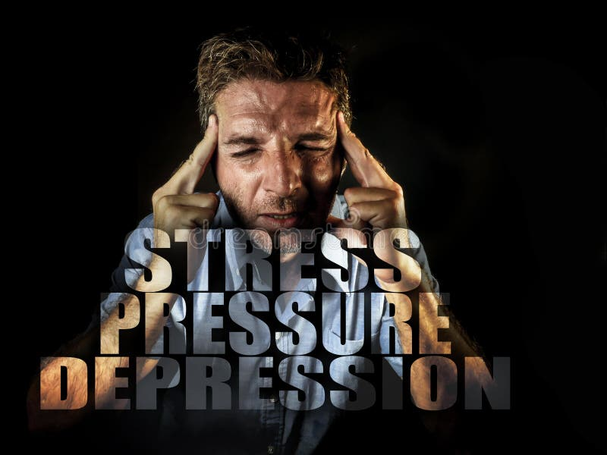
The Composed Man
Notes:
Many men grow up believing they must always be composed.
Being composed is often defined as remaining calm, in control of your emotions, and self-possessed, especially under pressure. These are valuable skills. The ability to think clearly, communicate effectively, and respond rather than react can be sign of emotional maturity.

Slide 6

Emotions
Growing up taught being angry and pissed off was ok but being hurt was not.
We can only connect to others as deep and solid as we can connect to ourselves.
Brene Brown
Notes:
1. Places We Go When Things Are Uncertain or Too Much
Stress: Feeling overwhelmed or under pressure.
Overwhelm: An extreme form of stress when you can’t function.
Anxiety: A feeling of worry or fear about the future.
Fear: A response to a real or perceived threat.
Dread: A mix of fear and anticipation.
2.. Places We Go When We Feel Wronged
Anger: A response to injustice, boundaries being crossed.
Contempt: A mix of disgust and anger, feeling morally superior.
Disgust: A revulsion toward something we find offensive or toxic.
Perfectionism is not the same thing as striving to be our best. Perfectionism is, at its core, about trying to earn approval and acceptance. It’s a shield we use to protect ourselves from feeling inadequate
In her TED Talk and in her book "The Gifts of Imperfection," she explains that perfectionism is like carrying around a 20-ton shield, which you believe will protect you from shame, judgment, and criticism.

Slide 7
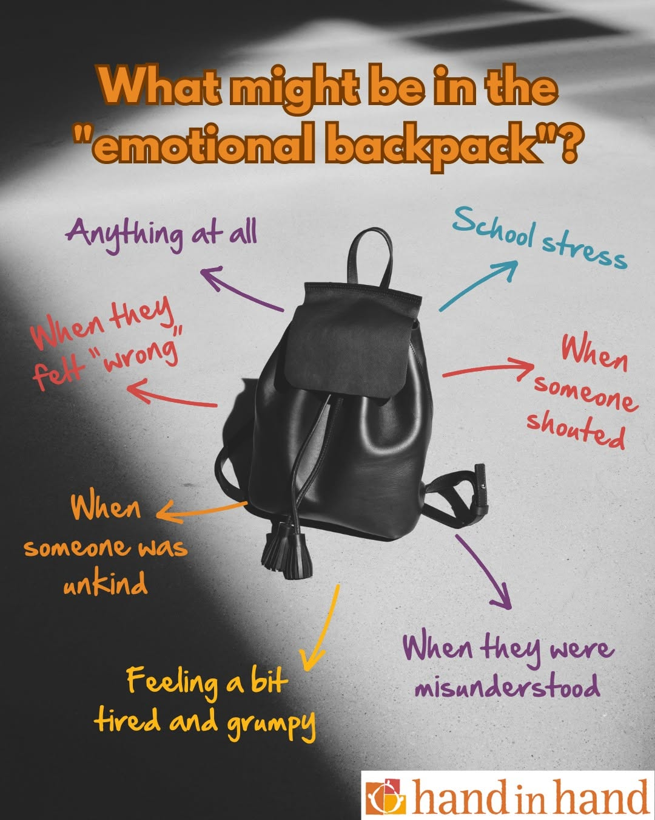
Notes:
If you talked to your friends the way you talk to yourself, how many friends would you have?

Slide 8

Emotional Straight Jacket
Men live in an emotional straight jacket
If a man shows real pain, people get uncomfortable
We are told to man up
We get looked at differently
Even by women who say they want a sensitive man
Notes:
Invisibility-unless a man is high status or extremely attractive, we are background noise. We get no compliments, no smiles, and no validation at all, not like women. Nothing
Male Hierarchy
Shame thrives in Secrecy silence and judgement
Brené Brown's research on shame found that it thrives in three environments: secrecy, silence, and judgment. Many men learn early to keep struggles private, remain silent about emotional pain, and fear being judged if they reveal vulnerability.

Slide 9
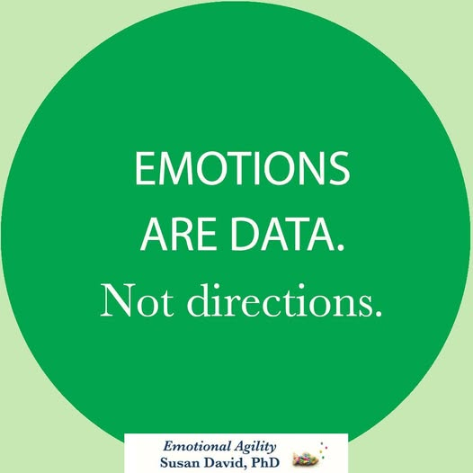
Notes:
Example- Traffic
Brené Brown explains that anger is often a secondary emotion—it feels safe and powerful, but underneath it usually hides hurt, fear, disappointment, shame, or grief. In many cultures, including law enforcement, anger is acceptable, but vulnerability isn’t. Emotions are data, not directives

Slide 10
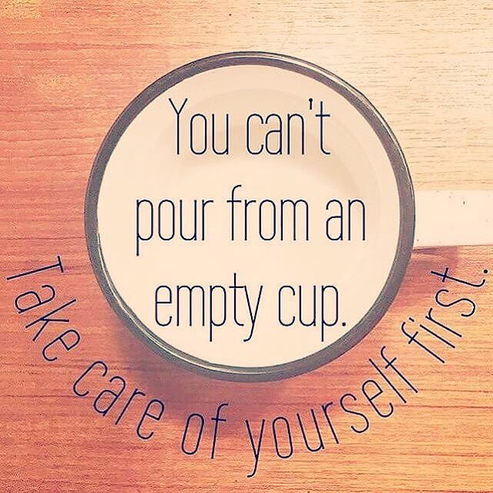
Notes:
Every day in the legal profession asks something of you—your focus, your judgment, your patience, and often, your peace of mind.
Case after case, hearing after hearing, decision after decision—it adds up. The difficult testimony, the high-conflict disputes, the weight of people's futures resting on your words and decisions. Even on the "routine" days, there is a constant level of responsibility that rarely allows your mind to fully disengage.
And if nothing is pouring back in, eventually you begin to feel it—running on empty.
It may show up as exhaustion, irritability, emotional distance, difficulty concentrating, or simply the feeling that you've lost the sense of purpose that once brought you into this profession.
The truth is, your work carries an emotional weight that often goes unseen. Whether you are a magistrate making difficult rulings, a judge presiding over life-changing decisions, or an attorney advocating for clients through conflict and crisis, you are regularly exposed to stress, trauma, and human suffering.
You are expected to remain composed, objective, and professional, even when the circumstances around you are anything but.
Yet the legal profession has traditionally emphasized taking care of the case, the client, the court, and the system—while giving far less attention to taking care of the people entrusted to uphold justice.
This course is about changing that.
It is about recognizing the personal cost of serving in the legal profession without shame or judgment.
It is about understanding that chronic stress, compassion fatigue, secondary traumatic stress, decision fatigue, and burnout are not signs of weakness. They are predictable occupational hazards of carrying significant responsibility for long periods of time.
Most importantly, this course is about learning practical, evidence-based strategies to restore your resilience, protect your well-being, and sustain the work you have dedicated your career to.
Because the quality of justice depends on the well-being of those who deliver it.
You cannot continually give your best when you are running on empty.
And you shouldn't be expected to.

Slide 11

What It Looks Like to Pour Without Refilling
Notes:
What It Looks Like to Pour Without Refilling (Internal depletion)
(Cup demo script)
Co-worker stress → you pour
Call after call → you pour
Life outside work → you pour
Little time to refill
Pause (cup nearly empty)
It’s not one moment—it’s accumulation

Slide 12

Understanding your “why” means:
Connecting with your core purpose, values, and motivations —
the deeper reason behind what you do.
Often, that “why” is this:
Becoming the person you needed.
The presence you once wished for
The protection you didn’t have
The steadiness someone showed you — or didn’t
Notes:
We master the what and the how, but the why often fades. Today, we’re taking a moment to reconnect with the purpose behind the work.
When you understand your why, your what becomes more meaningful because you’re moving with purpose. Take a moment to think about your why and share if you’re comfortable.
For leaders, this clarity is essential. True leaders don’t just stand at the top of the mountain and point the way; they stand at the base, guiding, supporting, and teaching every step of the climb.
Bottom line (bold):
Your “why” isn’t a slogan.
It’s a lived experience.

Slide 13

Reframing Adversity
Notes:
Brené Brown:
Adversity is not a test of toughness—it’s a call to stay engaged without shutting down emotionally. The reframe is: struggle doesn’t mean failure; it’s part of being human. Meaning comes when you stay connected to yourself and others instead of armoring up.
Bessel van der Kolk:
Adversity lives in the body, not just the story. The reframe is: your reactions aren’t overreactions—they’re your nervous system doing its job. Recovery means helping the body process and release, not judging the response.

Slide 14
Resilience
The ability to adapt and recover when things are hard
Not about avoiding stress, but responding and resetting after it
What allows you to keep going without losing yourself in the process
Notes:
Gabor Maté:
Resilience is the capacity to stay connected to yourself—your needs, limits, and authenticity—even under stress.

Slide 15
Building Resilience
Noticing the strengths you already use in high-stress moments
Shifting how you interpret difficult experiences
Speaking to yourself in a way that is supportive, not critical
Notes:
Building resilience isn’t about adding something completely new
It starts with noticing the strengths you’re already using in high-stress moments
The way you stay composed
The way you make decisions under pressure
The way you keep going even when things are difficult
It also involves how we make sense of what we go through

Slide 16

You Are Enough
Notes:
“This is your cup.
When you take care of it, you don’t just get through the job—you stay steady in it.
Keep it filled, and you can keep giving without losing yourself.”

Slide 17


Slide 18


Review of Your TELUS Health Benefits

Slide 19
State of Alabama: EAP Benefits
Employees and dependents may receive up to five (5) visits/consults
at no charge each plan year.

Slide 22
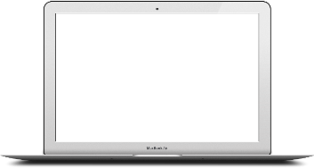
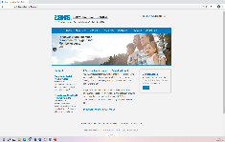
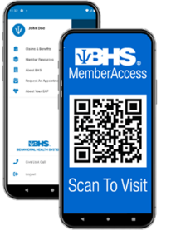

Digital Resources: TELUS Health MemberAccess
www.memberaccess.behavioralhealthsystems.com
TELUS Health MemberAccess in your App Store
  Work/Life ASSIST & EASE (NEW BENEFIT!)
  Benefit information including digital wallet card
  Appointment requests & forms
  Self-assessment tools
Two ways to login:
  Use your Employer ID: DORM
  Create a Unique User Login

Slide 23

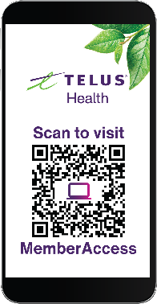
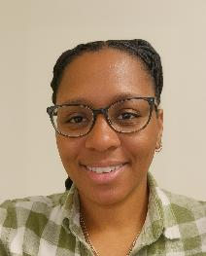
Accessing the TELUS Health Benefits
Begins with a call: 800-245-1150 or visit
MemberAccess.BehavioralHealthSystems.com
Designated Care Coordinator is available Monday-Friday: 7:00-5:00 CT / 8:00-6:00 ET
After-hour, weekend and holiday calls answered by mental health professionals – never an automated response system
Digital offerings also available via the TELUS Health MemberAccess app and portal
  To log in, use your Employer ID: DORM
Stormi White
MS, LMSW

Slide 24

A Personalized Approach To Behavioral Health
Behavioral health
EAP
& Work/life
Drug testing
Telehealth
& digital

