Slide 1
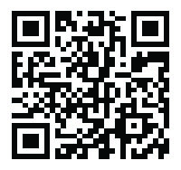


Workplace Incivility and Bullying: Identification, Prevention and Intervention
January 2023

Slide 2
State Employee Assistance Program
This presentation is part of the services provided by the State Employee Assistance Program through Behavioral Health Systems, Inc. The State EAP is administered and managed by the State Department of Finance’s Division of Risk Management (DORM). If you have questions regarding the policy, procedures or services provided by this program, please contact the Program Coordinator, Kwatasian Hunt, at kwatasian.hunt@finance.alabama.gov. You can also find more information about the State Employee Assistance Program on the Division of Risk Management’s website at www.riskmgt.alabama.gov.
Notes:
IMPORTANT PLEASE READ

Slide 3
Objectives
Define and learn to identify workplace bullying
Discuss the potential causes and effects
Recognize early signs of workplace bullying
Identify ways to prevent bullying in the workplace
Discuss intervention for both the management and the victim(s)
Review BHS benefits and resources available to State of Alabama employees and dependents

Slide 4
Workplace Bullying
Workplace bullying is repeated mistreatment by one or more employees that involves verbal abuse, behaviors perceived as intimidating or humiliating, work sabotage or some combination of the above
Can be as subtle as not inviting a specific coworker to lunch or as aggressive as sabotaging their work
Can create a risk to an employee’s health, safety or career
Notes:
How to Identify And Manage Workplace Bullying | Connecteam

Slide 5
Workplace Bullying
An estimated 48.6 million Americans have been bullied at work, amounting to 30% of adults
19% of individuals have witnessed workplace bullying
66% of employees are aware of bullying, even if they’re not involved
49% of workers feel personally impacted by workplace harassment
*2021 US Bullying Survey
Notes:
These stats came from the 2021 US Bullying Survey: https://www.knowledgecity.com/blog/the-latest-workplace-bullying-statistics-how-common-is-bullying-at-work/

Slide 6
Workplace Bullying
Bullies come in all shapes and sizes
Anyone can become a victim of bullying
Bullying can happen at any age
Males and females bully in different ways
Those victimized by bullying often don’t report it

Slide 7
Types of Workplace Bullying
There are four main types of bullying:
  Aggressive: Bully might scream, threaten or use other means of intimidation
  Gatekeeper: Bully might withhold resources or relationships to manipulate others into doing what they want, including taking credit for someone else’s ideas, work sabotage or even ignoring a coworker completely

Slide 8
Types of Workplace Bullying
Four main types of bullying (cont.):
  3. Critical: Uses criticism, mockery, jokes, gossip or other methods to humiliate and exclude coworkers
  4. Institutional: A company accepts, allows or encourages forced overtime that singles out an employee or group of employees
Because bullying is oftentimes psychological, it may not be visible to others

Slide 9
Examples of Workplace Bullying
Aggressive language
Gossip and rumors
Threatening gestures
Physical violence
Practical jokes
Sharing sensitive photos
Spreading rumors
Social exclusion

Slide 10
Examples of Workplace Bullying
Workplace bullying from managers can include:
Unjustified negative performance reviews or demotion
Consistently denying requested time off
Blocking promotions or requests to change departments
Being treated differently than other team members
Excessive monitoring or micromanaging

Slide 11
Causes of Workplace Bullying
A bully’s behavior is usually driven by a need to control
These employees want to call the shots and often insist on having things their way
Many times, bullies relate well to others and have a lot of influence with the company, resulting in these behaviors meant to control other people

Slide 12
Causes of Workplace Bullying
Sometimes workplace bullies target their co-workers out of jealousy
  Bullying is an attempt to reduce the target’s recognition by turning others against them
Other times, workplace bullying occurs because the bully has poor impulse control
  When this happens, the bullies are likely to use direct insults and negative comments

Slide 13
Effects of Bullying for an Employee
Depression
Anxiety
Isolation
Headaches
Muscle Tension
Digestive Issues
Higher Heart Rate/ Blood Pressure
Changes in Eating
Changes in Sleep
Increased Self Doubt
Suicidal Thoughts

Slide 14
Effects of Bullying in the Workplace
Low Productivity
Lowered Morale
Decreased Trust
Increased Absences
Disengagement
High Employee Turnover
Loss of Profit: Over $18 billion is wasted every year due to the effects of workplace bullying
Notes:
How to Identify And Manage Workplace Bullying | Connecteam

Slide 15
Workplace Bullying:
Prevention & Intervention

Slide 16
Workplace Bullying Risk Factors
The following factors can increase the risk of workplace bullying:
Major internal restructuring
Lack of employee participation in decisions
Little to no communication between organizational levels

Slide 17
Workplace Bullying Risk Factors
Lack of policies about behavior
High rate and intensity of work
Staff shortages
Organizational constraints
Role ambiguity/confusion

Slide 18
Early Signs of Workplace Bullying
A victim of workplace bullying may notice they are:
Feeling ill the night before the start of a work week
Obsessing about work off-hours
No longer interested in activities with family or friends

Slide 19
Early Signs of Workplace Bullying
A victim of workplace bullying may notice (cont.):
Questioning if somehow the cruelty is deserved
Spending off days exhausted and lifeless
Using all paid time off for "mental health breaks"

Slide 20
Early Signs of Workplace Bullying
The victim of workplace bullying may report:
That others at work have been told to stop working, talking or socializing with them
They are never left alone to do their job without interference

Slide 21
Early Signs of Workplace Bullying
The victim of workplace bullying may report (cont.):
Being told that harassment isn't illegal and/or that individuals MUST "work it out between yourselves”
That they were accused of harassment after confronting the bully

Slide 22
Workplace Bullies
In many cases, bullies are high performers so the company has incentive to keep those employees on board and happy
If the bully is manipulative, they may even come off as ‘helping’ by criticizing or taking over projects
Bullies may put on a friendly front with upper management to avoid any serious repercussions
Notes:
How to Identify And Manage Workplace Bullying | Connecteam

Slide 23
Preventing Workplace Bullying
Employers can help prevent and decrease workplace bullying by:
Creating an environment where open communication is rewarded
Encouraging the reporting of unacceptable behavior and bullying

Slide 24
Preventing Workplace Bullying
Creating an anti-bullying policy that:
    Defines workplace bullying and unacceptable behavior
    Explains the procedure of how your company plans to investigate
    Is part of the wider commitment to a safe and healthy environment
    Has the full support of top management

Slide 25
Preventing Workplace Bullying
Regularly monitoring, reviewing and revising the policy as needed
Ensuring managers have an active relationship with the staff they supervise
Training management to identify and stop bullying
Conducting employee attitude surveys

Slide 26
Preventing Workplace Bullying
Holding awareness campaigns for all staff on bullying
Establishing an independent contact for employees, such as an HR contact
Offering EAP services to all employees to seek help with work-related and personal problems

Slide 27
What Do I Do If I’m Being Bullied?
Regain control by:
Recognizing that you are being bullied
Realizing that you are not the source of the problem
Recognizing that bullying is about control and has nothing to do with your performance

Slide 28
What Do I Do If I’m Being Bullied?
Learn about your company’s behavioral policy regarding employee conduct, informing supervisors of misconduct and the complaint process
Speak directly to the person bullying you if you feel safe; calling out the bully may stop them from continuing their behavior
If the bullying continues, involve a manager or HR Representative
Notes:
Learn about your company’s behavioral policy. Find out all details regarding employee conduct, how to inform supervisors of misconduct, and the steps the company takes once a complaint has been filed.
If you feel safe, speak directly to the person bullying you. Calling out the bully may stop them from continuing to bully you. It’s possible the bully may not even be aware that they are harassing you and once you bring it to their attention they have the opportunity to stop before it escalates.
If the bullying continues involve a manager or HR assuming the bullying isn’t coming from HR or management. Let them know of the situation and find out how they can help.

Slide 29
What Do I Do If I’m Being Bullied?
Gather any evidence supporting your claims
  Include exactly what happened, dates and times of incidents and witnesses that saw the incident
  If the bullying was via email or another form of written communication, save the documents
If HR or management hasn’t solved the issue, file an official complaint with them
Notes:
Keep records. Gather any evidence supporting your claims, including dates and times of specific incidents, any witnesses that saw what happened, and what exactly happened. If the bullying was via email or another form of written communication, save the documents.
File an official complaint if HR or management hasn’t solved the issue. Once a formal complaint is filed, they will have to investigate or be held liable.

Slide 30
Intervening in Workplace Bullying
Take all claims seriously
Act quickly
Maintain confidentiality
Be neutral during the investigation
Support all employees
Be transparent with the investigation timeline

Slide 31
Intervening in Workplace Bullying
Communicate the process of the investigation
Keep all records
Once the bullying is resolved:
  Provide training for all staff
  Recommit to company policies
  Offer counseling to those affected

Slide 32
Review of Your BHS Benefits
State of Alabama

Slide 33




State of Alabama: EAP Benefits
All employees and dependents may receive up to
three (3) visits/consults at no charge each year.
Behavioral
Speak with Counselors
Referrals for mental/ behavioral health & substance abuse issues
Financial
Speak with Advisors
Assistance with budgeting, estate planning, college, debt restructuring, etc.
Eldercare
Speak with Professionals
Help with nursing home & assisted living placement, caregiver issues, etc.
Well-Being
Speak with Work/Life Specialists
Help with stress, emotional health, work/life balance, etc.

Slide 34


Accessing the EAP
Begins with a call to BHS: 800-245-1150
BHS Care Coordinator is available Monday-Friday
from 7:30 a.m. – 5:00 p.m. CT
Your BHS Care Coordinator will:
Verify personal information to confirm benefit eligibility
Ask a few questions about needs and preferences
Assist in referring to the appropriate counselor or provider
After hour, weekend and holiday calls answered by licensed mental health professionals – never an automated response system

Slide 35



Accessing the EAP
Dedicated BHS Care Coordinator
When you call BHS, you will speak with the BHS Care Coordinators assigned specifically to the State of Alabama:
Marie Wilbanks and
Emme Blankenship
BHS Care Coordinators
Caring, knowledgeable, credentialed counseling professionals who have been selected for their commitment to treat everyone with sensitivity, respect and concern

Slide 36
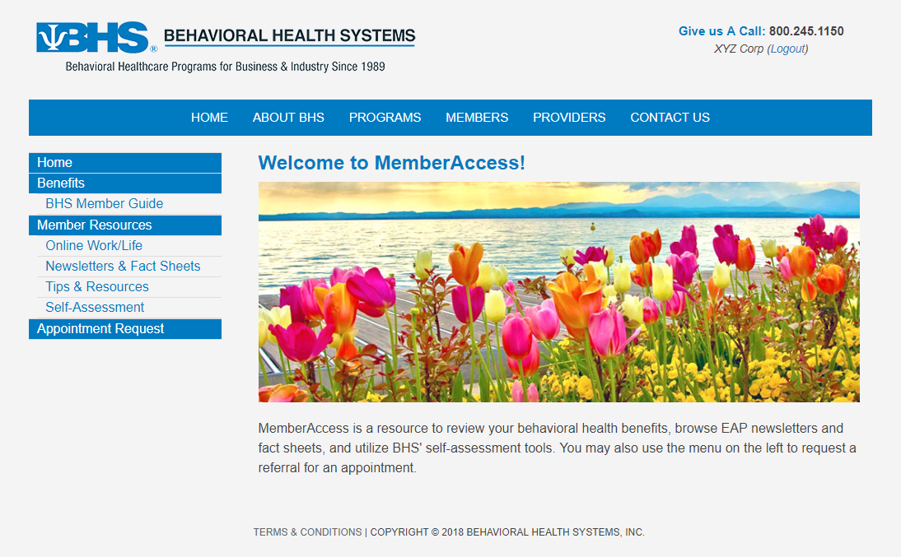
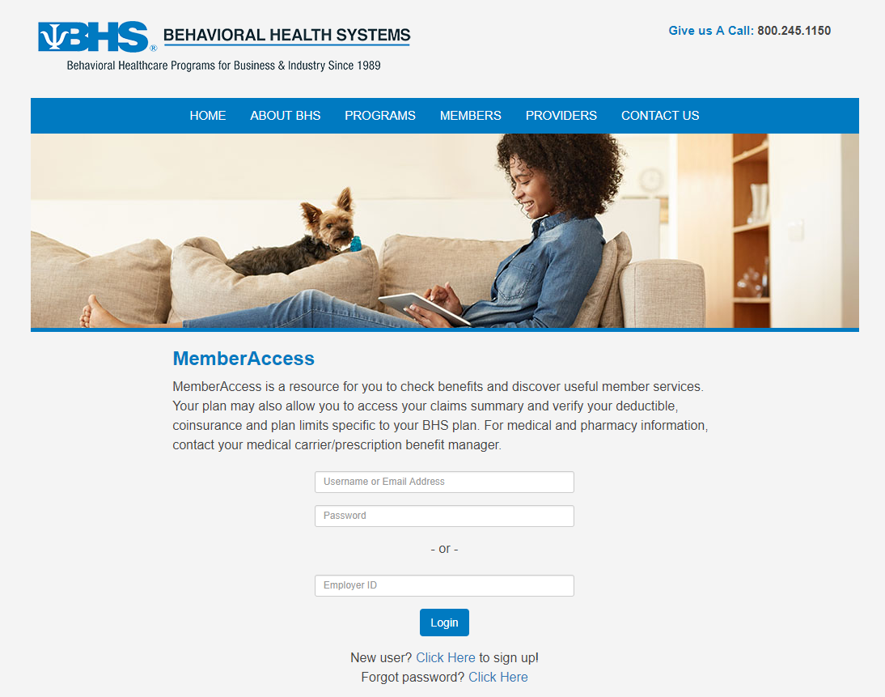
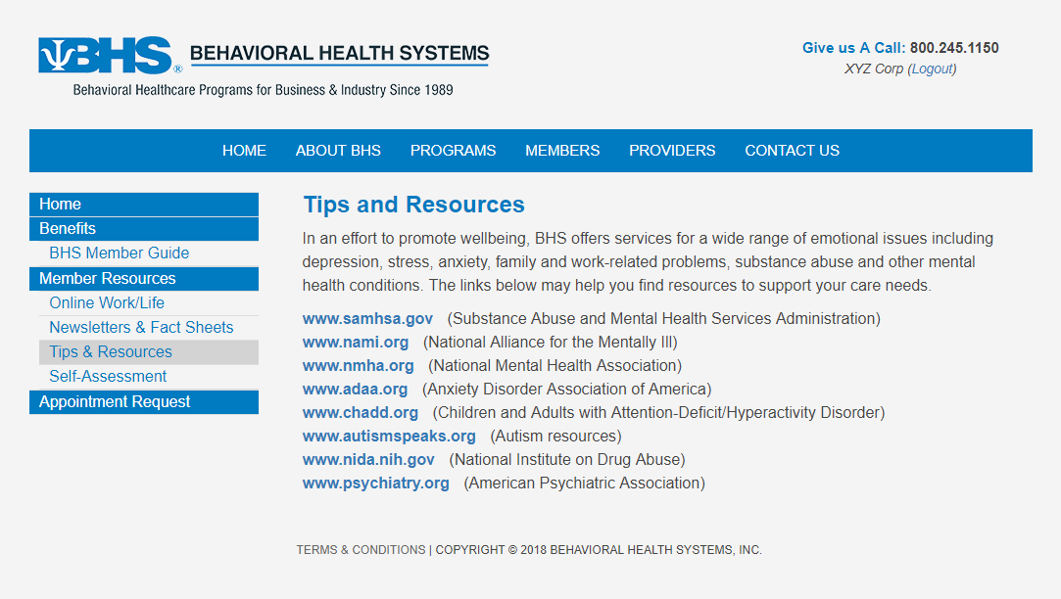
More Information About Your EAP Benefit www.behavioralhealthsystems.com
BHS Website
Resources
Access to:
Benefit Information
Member Tips & Resources
Self-Assessment tools
Newsletters & Fact Sheets
Appointment Requests
Two ways to login to MemberAccess:
Use your Employer ID: DORM
Create a unique user login
Notes:
More information about your EAP benefit is available at our website. Enter the Members section, click on Member Login and enter your password, DORM, to view your member guide and to use self-assessment tools.

Slide 37

BHS Website:
www.behavioralhealthsystems.com
Access to:
Enhanced Member Section detailing your unique benefits and services (Member Access)
Member Tips & Resources
Self-Assessment Tools
Appointment Requests
Online Work/Life (password: DORM):
Lifestyle tools to support a healthy work/life balance
Extensive library providing access to relevant articles, seminars, self-help information, news items and more

Slide 38
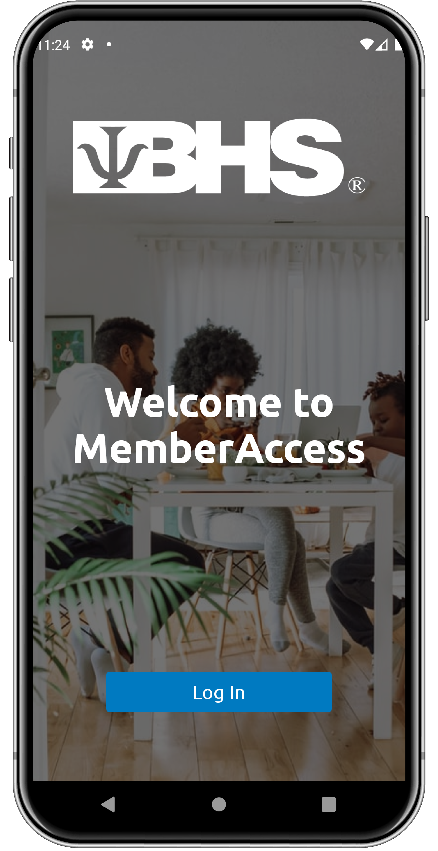
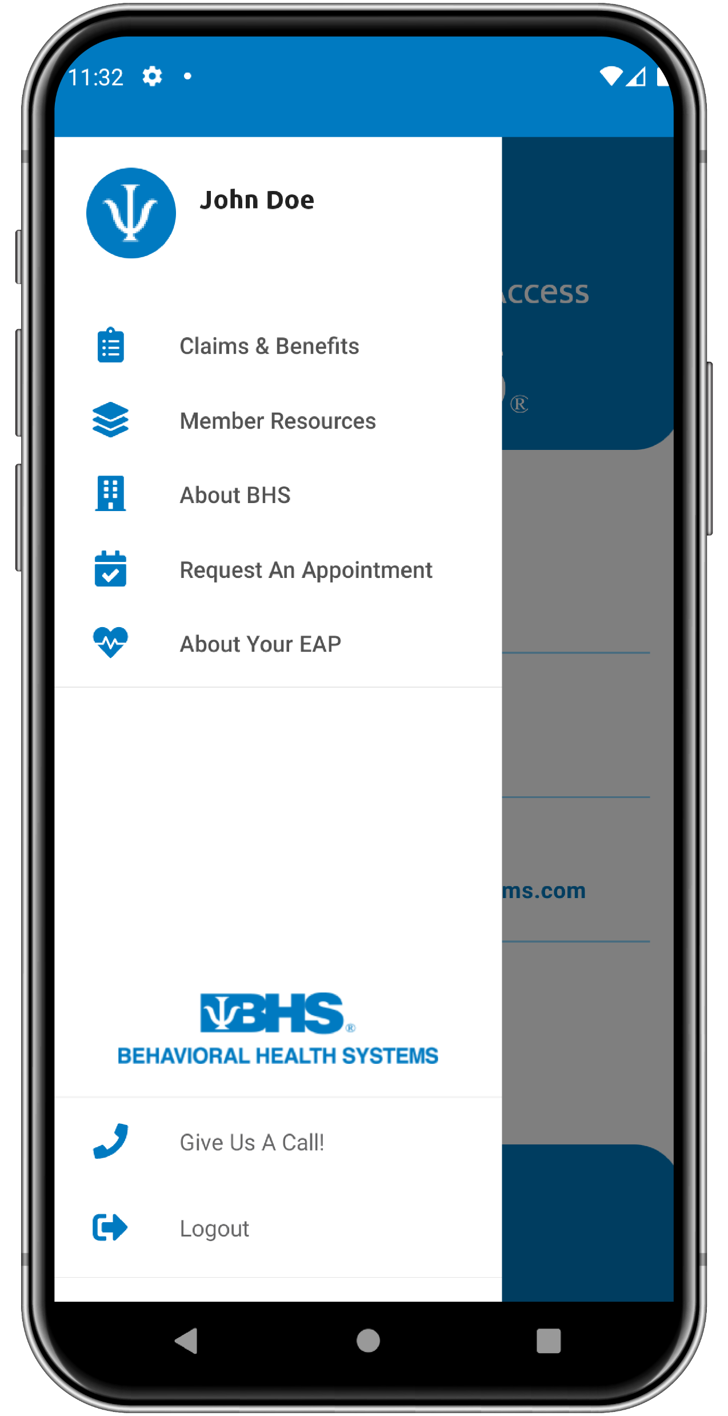

BHS MemberAccess Mobile App
Now it’s Easier Than Ever to Access…
Benefit Information
Member Tips & Resources
Self-Assessment Tools
Newsletters & Fact Sheets
Appointment Requests
Reimbursement Forms
Online Work/Life
Two ways to login:
Use your Employer ID: DORM
Create a Unique User Login

Slide 39
Workplace Incivility and Bullying: Identification, Prevention and Intervention
January 2023

